Slide 1

Objectives
In this session, you will learn to:
  Create payroll masters

Slide 2
Pay Heads
From employee’s point of view, pay heads may be broadly considered as Earnings and Deductions.
However, from the employer’s point of view, these pay heads would still be Expense and Liability.
In Tally.ERP 9, each pay head is to be created as an individual ledger account and grouped under its respective group.

Slide 3
Pay Heads (Contd.)
The preset Pay Head types in Tally.ERP 9 are:
  Earnings for Employees
  Deductions from Employees
  Employees’ Statutory Deductions
  Employer’s Statutory Contributions
  Employer’s Other Charges
  Bonus
  Gratuity
  Loans and Advances
  Reimbursements to Employees

Slide 4
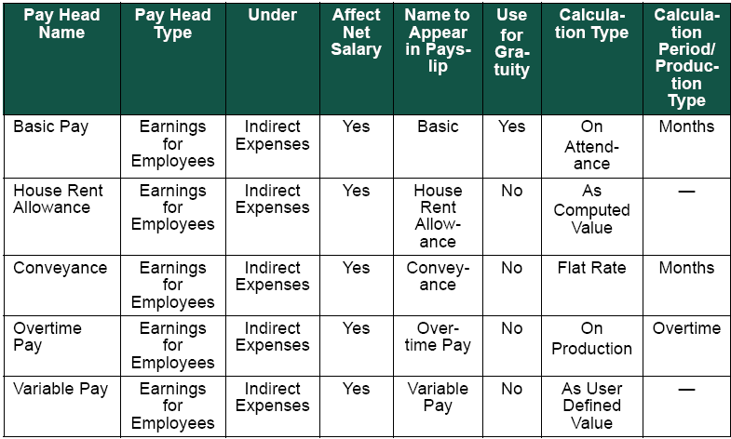
Demo: Creating Pay Heads
Problem Statement:
  Create the following pay heads in the books of M/s. Indus Solutions Pvt. Ltd.:
    Earning Pay Heads:
      Create the following Earning Pay Heads.

Slide 5

Demo: Creating Pay Heads (Contd.)
Let us see how to create Earning Pay Heads in Tally.ERP 9.

Slide 6
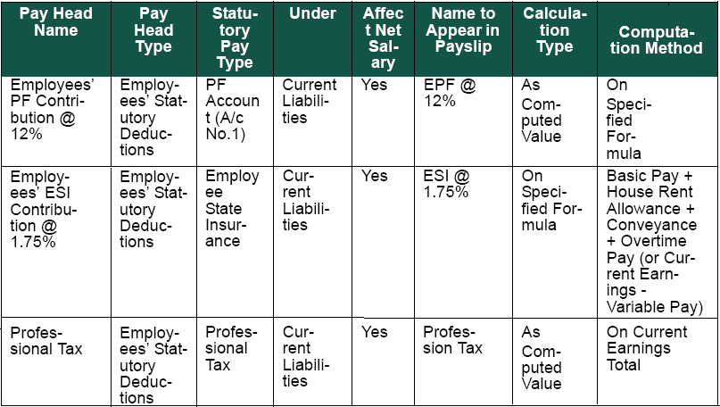
Demo: Creating Pay Heads (Contd.)
    Deduction Pay Heads:
      Create the following Deduction Pay Heads.

Slide 7
Demo: Creating Pay Heads (Contd.)
Let us see how to create Deduction Pay Heads in
Tally.ERP 9.

Slide 8
Gratuity
Gratuity refers to the monetary benefit given by the employer to the employee at the end of the employment for the services rendered over a period of employment.
It is calculated provisionally at the end of each financial period to assess the possible liability of the company towards its employees.

Slide 9
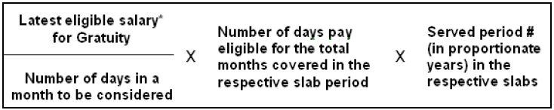
Gratuity (Contd.)
The following figure shows the formula used for caluculating Gratuity calculation.

Slide 10
Demo: Creating Gratuity Pay Heads
Let us see how to create Gratuity Pay Heads in Tally.ERP 9.

Slide 11
Salary Details Setup
The salary details masters contain information on the employee group or individual employee pay structure, comprising both earnings and deductions pay components for the applicable period.
Tally.ERP 9 allows you to set up individual employee salary details with all parameters applicable for employee groups.

Slide 12
Demo: Creating Salary Details
Let us see how to create salary details in Tally.ERP 9.

Slide 13
Summary
In this session, you learned that:
  Salary components constituting Pay Structures are called Pay Heads.
  Gratuity is a monetary benefit paid by an employer to an employee, at the end of the employment, for the services rendered over the period of employment.

